Slide 1
Introduction
01) Basics of Python
02) Data Analysis with Pandas
03) Basics of Forex
04) Algorithmic Trading with mt5 Library
Building the Strategy Plan
Assembling the bot
Live Trading
Bot 01: Building a Simple Forex Trading Bot to Understand Fundamentals -
Bot 02: Building a SMA Crossover Trading Bot -
Building the Strategy Plan
Assembling the bot
Bot 03: Building a Bollinger Bands Trading Bot -
Building the Strategy Plan
Assembling the bot
Bot 04: Building a Grid Trading Bot-
Building the Strategy Plan
Assembling the bot
Multiprocessing ( Trading Multiple Currency Pairs Simultaneously )
Live Trading
Bot 05: Building a DCA Trading Bot -
Building the Strategy Plan
Assembling the bot
Multiprocessing ( Trading Multiple Currency Pairs Simultaneously )
Live Trading

Slide 2
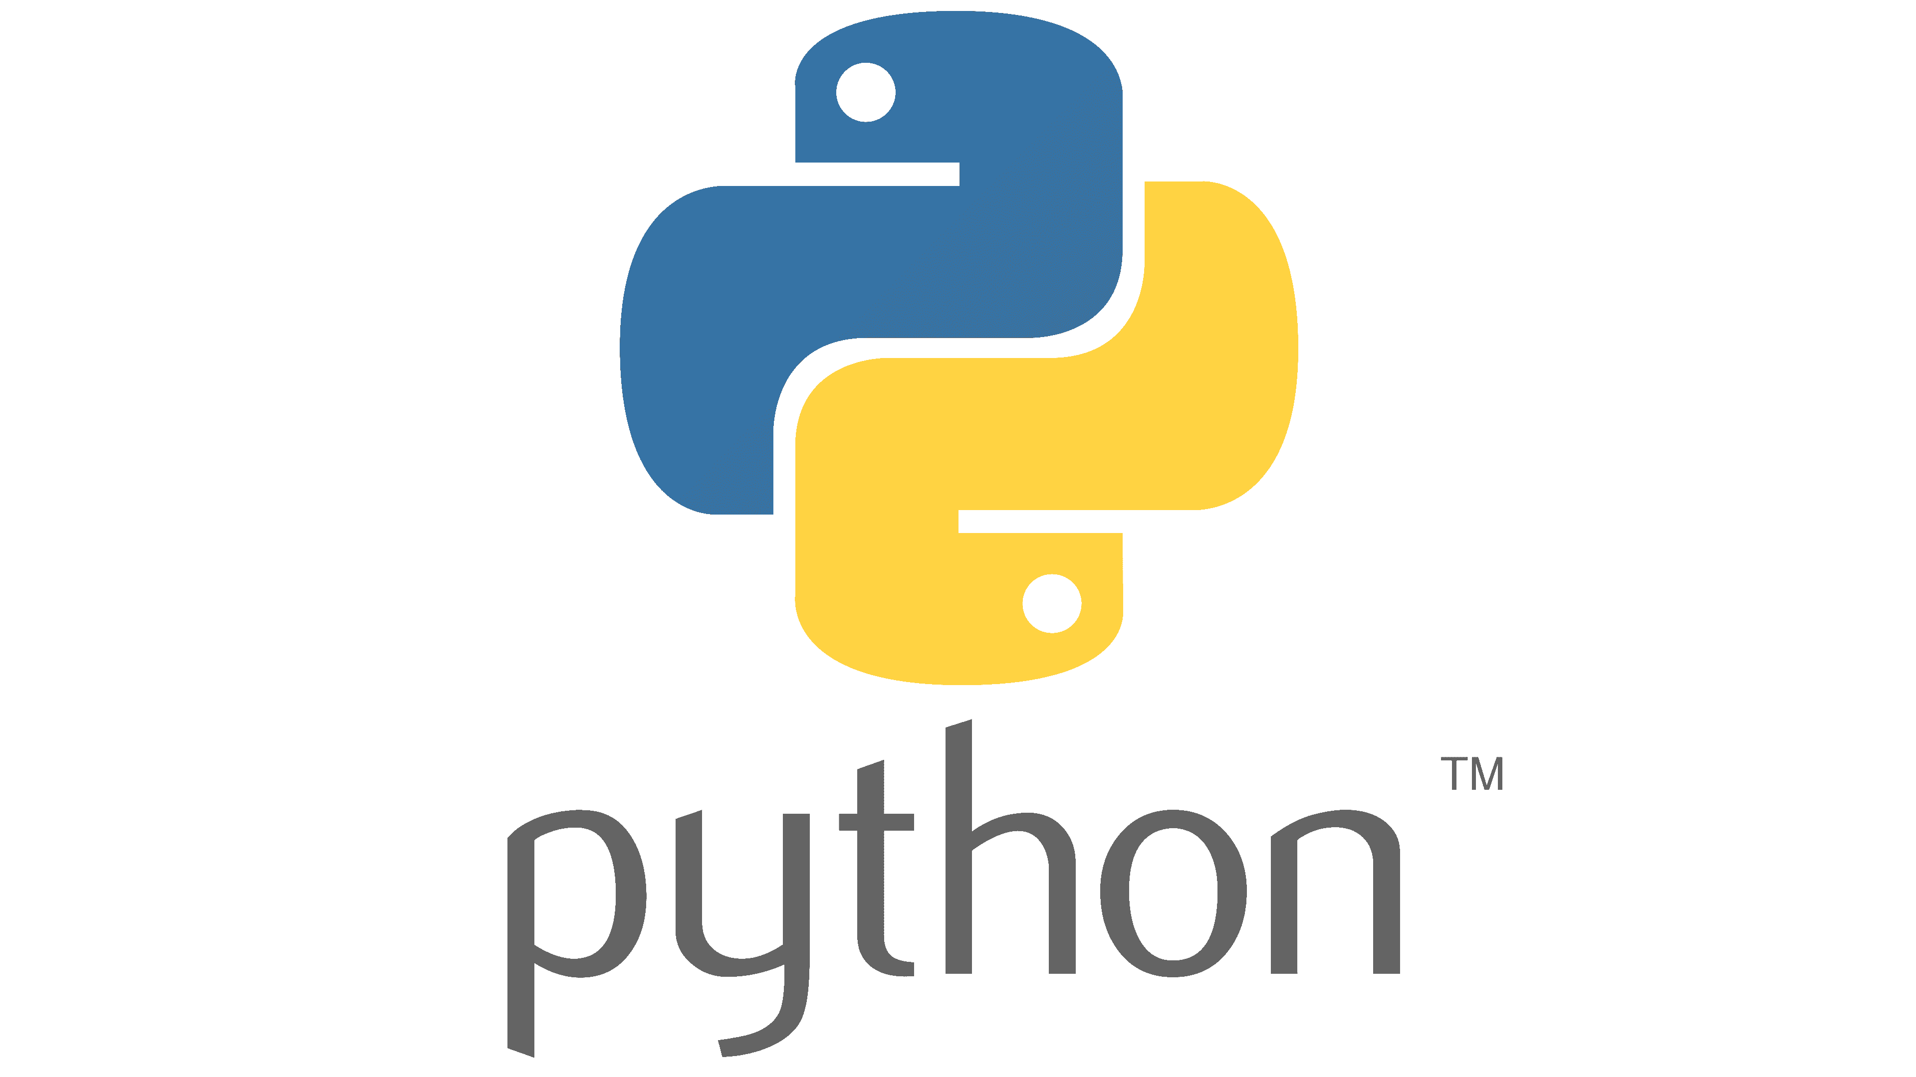
01)Basics of Python
This section is for absolute beginners in python. We are discussing about following topics.
Installing Python and Setting up IDE
Print Function and F Strings
Variables and Basic Data Types in Python
Operators in Python
Python Functions
Global and Local Variables in Python
Working with Lists
Working with Dictionaries
If Else Statements in Python
While Loops, Break and Continue Statements
For Loops
Classes and Objects in Python

Slide 3

02)Data Analysis with Pandas
Pandas is a Python library created for data analysis. We are using this library to do essential forex calculations.
Pandas Series
Pandas Data Frames
Selecting Specific Rows and Columns in a Dataframe
Selecting Rows in a Data Frame by Conditions
Iterating Colums in a Dataframe

Slide 4

03)Basics of Forex
We will discuss terminology in forex and do essential calculations.
Installing MetaTrader and Setting Up a Correct Broker Account
Types of Currency Pairs in Forex
Bid, Ask and Spread
Lots, Pips , Leverage and Margin
Essential Calculations
Types of Orders in Forex

Slide 5

04)Building the Strategy Plan
In this section, we will be designing blue print of our trading bot

Slide 6

05)Algorithmic Trading with mt5 Library
We are creating functions of our trading bot
Opening and Closing Different Types of Orders with Python
Getting Current Position Details
Basic Calculations ( Profit/Loss , Margin , Total Volume )
06)Building the Trading Bot
We are putting all the functions together and assembling the bot

Slide 7


07)Multiprocessing
We are upgrading our bot to trade multiple currency pairs simultaneously
08)Live Trading
Finally lets do some live trading

